Slide 1

Quantitative Data Analysis using SPSS (Part II)
February 27, 2021, 8:30am-12:00nn
Dr. Victor V Hafalla Jr., REE
Faculty: UB-SEA, Graduate School
University Statistician

Slide 2

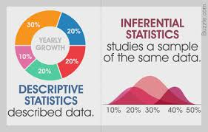
Inferential Statistics
comprise those methods concerned with the analysis of sample data leading to predictions or inferences about the population
Source:https://sciencestruck.com/descriptive-vs-inferential-statistics

Slide 3
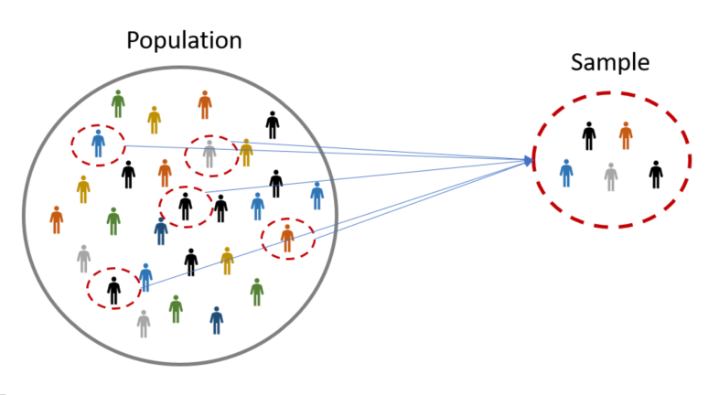
Population vs Sample
Population
is a collection of all the elements under consideration in any statistical study
Sample
is a part (or subset) of the population from which information is collected
Source:https://www.omniconvert.com/what-is/sample-size/

Slide 4
Parameter vs Statistic
Parameter
is a numerical characteristic of the population
(example: population mean, population variance, population proportion)
Statistic
is a numerical characteristic of the sample (example: sample mean, sample standard deviation, sample variance)

Slide 5
Parameter vs Statistic
Parameter
is a numerical characteristic of the population
(example: population mean, population variance, population proportion)
Statistic
is a numerical characteristic of the sample (example: sample mean, sample standard deviation, sample variance)

Slide 6

Probability Theory and Test Statistics
Probability Theory allows us to calculate exact probability where chance is the real reason for the outcome/relationship.
Eg. Consider tossing a coin, the outcome is either head or tails with a probability of 50% each.
Eg. Consider tossing a die, the probability of getting an even number in a single toss is 3/6 or ½ or 50%.
Pierre Simon de Laplace
1749-1847

Slide 7
Probability Theory and Test Statistics
Probability allows us to produce statistics and statistics tables (using mathematical formulas).
Eg. Normal or Z-distribution, Binomial distribution
Chi-square distribution, F-distribution
A test statistic is a number that is used to decide whether to accept or reject the null hypothesis.
The most common statistical tests include: Chi-square, t-test, ANOVA, Correlation, Regression

Slide 8
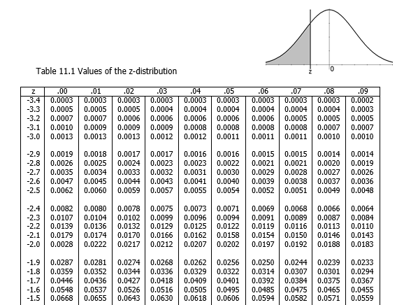
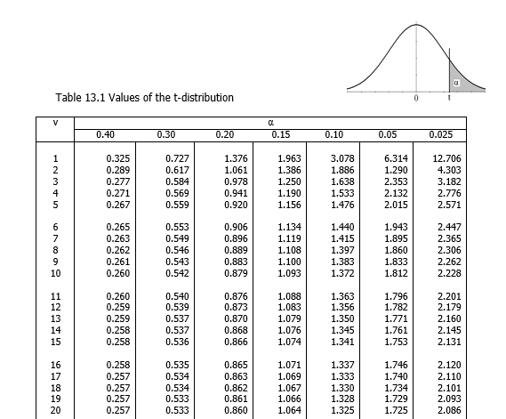
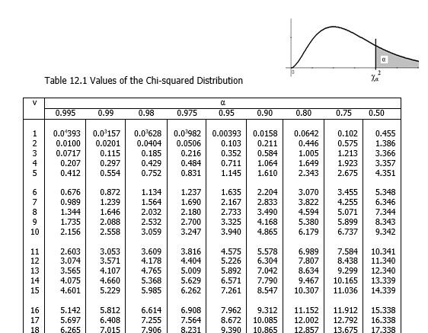
Some Statistics Tables
The Z-distribution of the Normal Curve
The t-distribution
The χ² -distribution

Slide 9
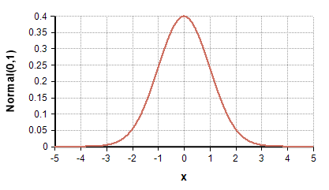
THE NORMAL DISTRIBUTION
The normal distribution is one of the most important distributions in Statistics. Many real life occurrences can be represented by this distribution and many statistical methods and processes assume the condition of normality in their data set.
Other distributions such as the t-distribution, Chi-squared distribution and F-distribution are derived from random variables that assume the normal distribution.
Source:https://wiki.analytica.com/index.php?title=Normal_distribution

Slide 10
Definition of a Normal Random Variable
A continuous random variable X having the normal distribution is called a normal random variable. The mathematical equation for the probability distribution of the normal random variable depends on its mean and standard deviation (μ, σ). Thus, the probability density function of the normal random variable X, with mean μ and variance σ² is

Slide 11
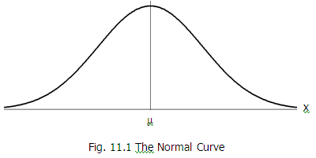
Properties of the Normal Curve
The normal distribution assumes a bell-shaped curve known as the normal curve. It has the following properties:
1. The distribution is bell-shaped, single-peaked and symmetric with respect to x=μ. It has a zero skewness and is mesokurtic.
2. The curve is asymptotic with respect to the horizontal axis (x-axis).
3. The total area (probability) of the curve is equal to 1.
4. The curve has its point of inflection at x= μ ± σ.

Slide 12
Statistical Hypothesis
A statistical hypothesis is an assertion or conjecture concerning one or more populations.
The truth or falsity of a statistical hypothesis is never known with absolute certainty unless we actually examine the entire population. Because of this, we usually rely on a sample from the population of interest and use the data from the sample to provide proof that either supports or contradicts the hypothesis. This procedure is known as hypothesis testing.

Slide 13
Statistical Hypothesis
Two forms of statistical hypotheses exists: the null hypothesis (denoted by Ho) and the alternative hypothesis (denoted by Ha).
The null hypothesis (Ho) is the hypothesis to be tested and it represents what the investigators doubts to be true.
On the other hand, the alternative hypothesis (Ha) is the operational statement of the theory that the experimenter or researcher believes to be true and wishes to prove.

Slide 14
Rejection of the Ho
The rejection of Ho leads to the acceptance of Ha.
However, failure to reject Ho does not imply its acceptance but only merely states that there is insufficient evidence to refute it. In this case, it is best to reserve judgment until new evidence (from another batch of sample) confirms the decision.

Slide 15

Type I and Type II Errors
The rejection of the null hypothesis when in fact it is true is called a type I error. On the other hand, the acceptance of the null hypothesis when it is false is called a type II error.
The probability of committing a type I error is also called the level of significance (α). The probability of committing a type II error is denoted by its statistical power (β).
The α and β are inversely related.

Slide 16
One Tailed and Two-tailed Test
Tests of hypotheses could either be one-tailed (also called directional or one-sided) or two-tailed (non-directional or two-sided).
A one-tailed test occurs when the researcher do have a priori expectation about the parameter they expect to observe.
A two-tailed test, on the other hand, is appropriate when the researcher does not have a priori expectation regarding the value they expect to observe in the sample.

Slide 17
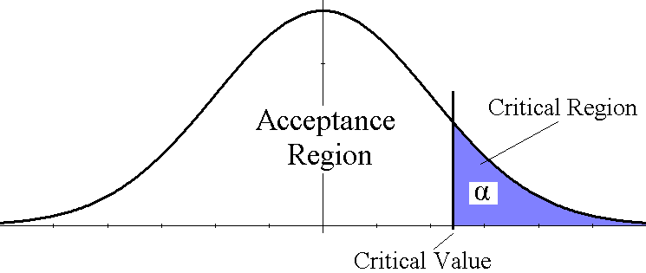
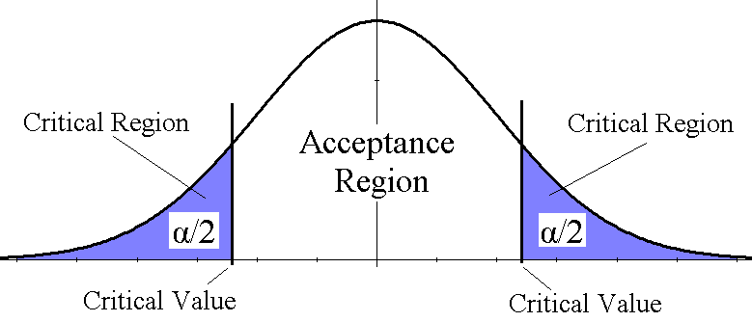
One Tailed and Two-tailed Test
ie. μ > 50, μ₂ – μ₁ > 0,
ρ > 0, P > 0.75
Note: It is also possible to use less than symbol (<). In this case, the critical region and critical value would be on the left side
One-tailed test
Two-tailed test
ie. μ ≠ 50, μ₂ – μ₁ ≠ 0,
ρ ≠ 0, P ≠ 0.75

Slide 18
Quantitative Analysis Using the Traditional Approach: Hypothesis Testing
Steps in Hypothesis Testing
i. State the null hypothesis, Ho.
ii. Choose an appropriate alternative hypothesis, Ha, based from the problem (and determine whether the test is a one-tailed or two-tailed test).
iii. State the significance level, α.
iv. Select and compute the appropriate test-statistic.
v. Establish the critical region.
vi. State the decision: Reject Ho if the test statistic has a value in the critical region; otherwise, do not reject Ho.
vii. Restate the decision in laymen’s terms.

Slide 19
Example:
The contents of 6 similar containers of an acid are (in liters):
9.5, 8.2, 10.12, 9.9, 9.41, 10.2
The supplier claims that their shipment contains on average at least 10 liters of acid. Test this hypothesis at the 5% level of significance. Assume that the distribution of the contents of the acid in the containers is approximately normal.

Slide 20
Quantitative Analysis Using the Traditional Approach: Hypothesis Testing
i. State the null hypothesis (Ho):
Ho: μ=10
(The average acid content in the shipment is 10liters)
ii. Choose an appropriate alternative hypothesis, Ha, based from
the problem.
Ha: μ<10
(The average acid content in the shipment is less than 10 liters)
Note: Ha is one-tailed because of the directional keyword “at least”. We go against the claim of the supplier.

Slide 21
Quantitative Analysis Using the Traditional Approach: Hypothesis Testing
iii. State the significance level, α:
α=0.05
iv. Test-statistic: Since this is a small sample test, n<30, and since σ is
unknown we use the t-test. But first we calculate the sample mean
 = 9.555 and the sample standard deviation s=0.7368.
v. Critical Region: For a one-tailed test:
Note: v is the degrees of freedom and is equal to n-1

Slide 22
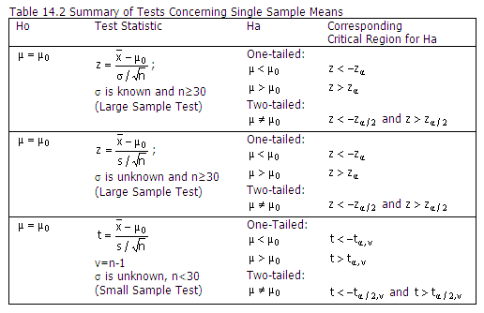
Quantitative Analysis Using the Traditional Approach: Hypothesis Testing
The test statistic to be used, degrees of freedom, critical region, null and alternative hypothesis can be found from most statistics books. One such such book is Shaum’s Outline of Statistics II: Inferential Statistics by Bernstein and Bernstein

Slide 23
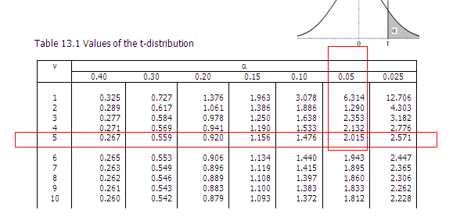
Quantitative Analysis Using the Traditional Approach: Hypothesis Testing
v. Critical Region: For a one-tailed test:
Note that v is the degrees of freedom and is equal to n-1. The t-value is found somewhere in the t-distribution table.

Slide 24
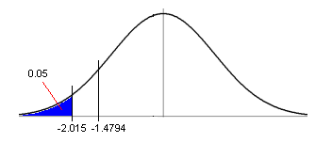
Quantitative Analysis Using the Traditional Approach: Hypothesis Testing
vi. Decision:
Since t=-1.4794 is not less than -2.015 , then we fail to reject Ho.
vii. Restate the decision in laymen’s terms:
Based from the sample data, there is no reason to doubt the claim of the supplier that the average acid content of the shipment is at least 10 liters. It is best to withhold judgment at this point.

Slide 25
Quantitative Analysis Using SPSS: The P-value
WHAT IS THE P-VALUE
The p-value is the smallest level of significance (α) that would lead to a rejection of Ho.
Most statistics computing software will compute for the p-value in reporting tests of significance. Sometimes these are found under the heading ‘sig’ or ‘asymp. sig’.
If the computed p-value is less than 0.05 then the conclusion is statistically significant and we “reject Ho” at the 0.05 level. If it is less than 0.01 then it is highly significant and we also reject Ho at the 0.01 level. This usually denotes a result of significant difference or significant relationship of the hypothesis test. If the p-value is greater than 0.05 then the conclusion is not significant and we “fail to reject Ho” at the 0.05 level. This indicates that there is no significant difference nor relationship between the given variables.

Slide 26
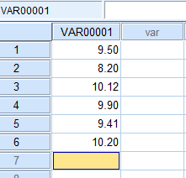

WORKSHOP 3: Test on a Single Sample Mean, One-Sample t-Test
1. We will use the data of the previous example. Open the SPSS Menu, click TYPE IN DATA, press OK.
2. Type in the data on a single column and then click VARIABLE VIEW below.
…

Slide 27

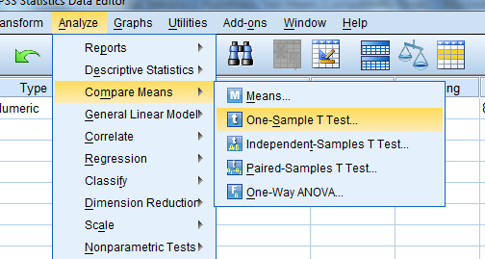
WORKSHOP 3: Test on a Single Sample Mean, One-Sample t-Test
3. Under the column heading NAME, change VAR00001 to ACID then click DATA VIEW below.
4. Click ANALYZE – COMPARE MEANS – ONE-SAMPLE T-TEST.

Slide 28
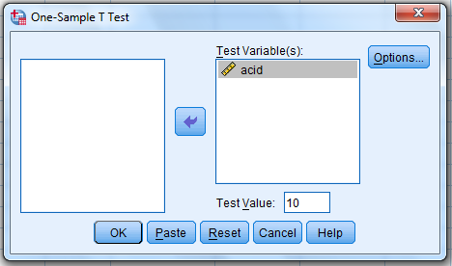
WORKSHOP 3: Test on a Single Sample Mean, One-Sample t-Test
5. Click on ACID and then the ARROW to the TEST VARIABLE(S). Next change the test value to 10 and then click OK.

Slide 29
WORKSHOP 3: Test on a Single Sample Mean, One-Sample t-Test
6. Results and interpretation:
Results indicate that we fail to reject the null hypothesis, Ho. Results of the one-sample t-test indicate that for a one-tailed test (Ha: µ<10), there is no reason to doubt the claim of the supplier that the average acid content of the shipment is at least 10 liters (t (5) = -1.479, p>0.05).

Slide 30
How do you determine which statistical test to use given the problems of the study?

Slide 31
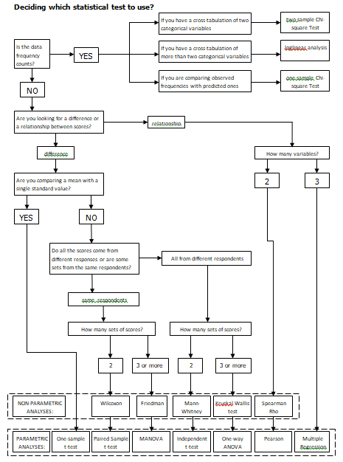
Rough Guide to Inferential Statistics
(see MSWORD file)
Note that this guide is not exhaustive and does not take into account the peculiarities of the data. However, it can be used as a general guide for novice researcher.

Slide 32
Workshop 4: Deciding on which Statistical Test to Use (Independent Sample t-Test)
Consider the data for nursing care SMI. Provide descriptive statistics and inferential statistics for the following research problems:
What is the average QOL of families with SMI considering the type of care provided, that is between direct and hired care?
1.1 Is there a significant difference on the mean QOL of
families with SMI between those opting for direct care and
those opting for hired care?

Slide 33
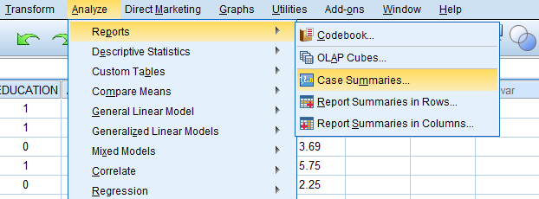
Workshop 4: Deciding on which Statistical Test to Use
The “average QOL of families with SMI considering the type of care provided” is descriptive statistics. We can use SPSS to make summary measures for groups of cases. Open the SPSS data for nursing care SMI. From the data editor, click ANALYZE > REPORTS > CASE SUMMARIES.

Slide 34
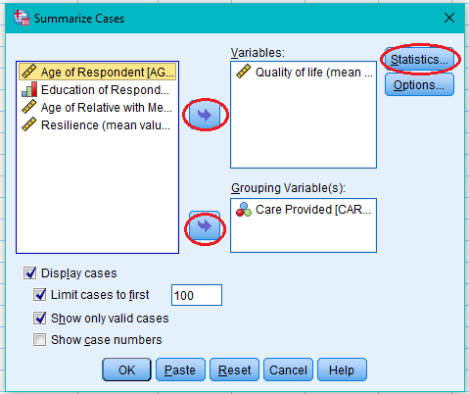
Workshop 4: Deciding on which Statistical Test to Use
Click the “Quality of life” to the Variable box and the “Care Provided” to the Grouping Variable(s) box. Afterwards click the Statistics button.

Slide 35
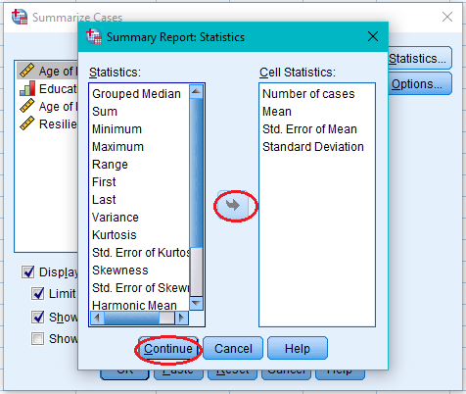
Workshop 4: Deciding on which Statistical Test to Use
Using the arrow, transfer the Mean, Std. Error of Mean, Standard Deviation to the Cell Statistics, then click Continue.

Slide 36
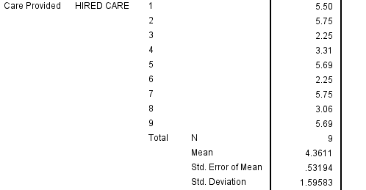
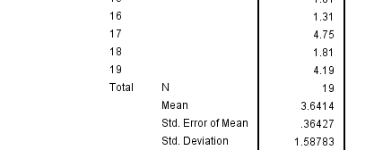
Workshop 4: Deciding on which Statistical Test to Use
From the output view, we can see that the mean QOL value for those with hired care is 4.36 with a standard deviation of 1.60 while those with direct care is 3.64 with a standard deviation of 1.59. (interpret the values using the given criteria of the study)

Slide 37
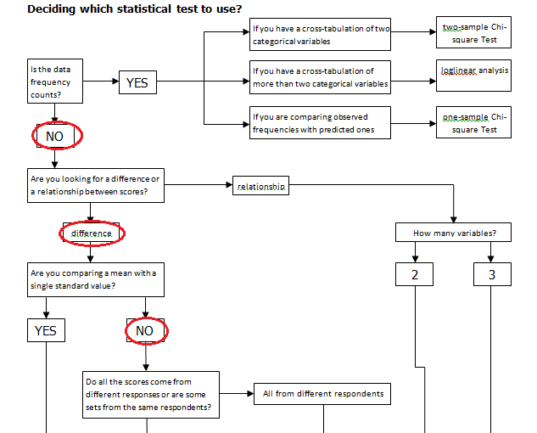
Workshop 4: Deciding on which Statistical Test to Use
1.1 For the research problem “Is there a significant difference on the mean QOL of families with SMI between those opting for direct care and those opting for hired care?”, we try to navigate the desired inferential statistics test using the given guide. In this problem we are comparing between two groups of numerical data. Following the guide that we have for inferential statistics (see MSWORD file), the reasoning is as follows:

Slide 38
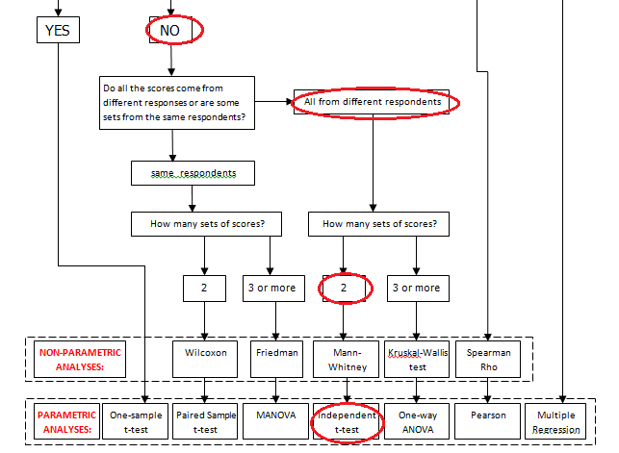
Workshop 4: Deciding on which Statistical Test to Use

Slide 39
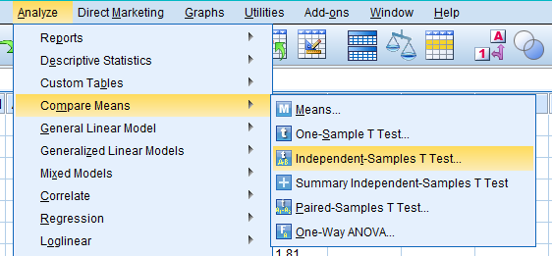
Workshop 4: Deciding on which Statistical Test to Use
1.1 To perform an independent sample t-test, from the data view click ANALYZE > COMPARE MEANS > INDEPENDENT SAMPLE T-TEST

Slide 40
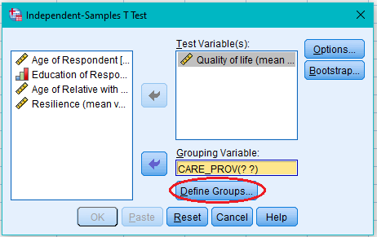
Workshop 4: Deciding on which Statistical Test to Use
Afterwards, transfer to the Test Variable box the Quality of life variable using the arrow and the CARE_PROV to the Grouping Variable box. Click Define Groups after.

Slide 41
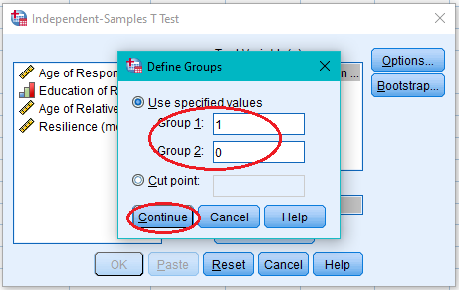
Workshop 4: Deciding on which Statistical Test to Use
Encode “1” for Group 1 and “0” for Group 2. Click Continue afterwards.

Slide 42
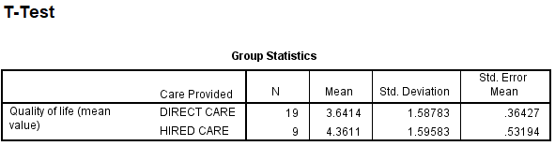
Workshop 4: Deciding on which Statistical Test to Use
Output:
Preliminary result on group statistics suggest that the quality of life (QOL) of family caregivers of those opting for hired care for their member/s of the family with SMI is 4.36 (s=1.60). This indicates that they have ‘mixed feelings of satisfaction’. For those who opted for direct care, ie. they are the ones giving the care for their family members with SMI, their QOL indicator gives an average value of 3.64 (s=1.59), also interpreted as ‘mixed feelings of satisfaction’.

Slide 43
Workshop 4: Deciding on which Statistical Test to Use
Output:
Levene’s test tests the assumption of equality of the group variances. The p-value of 0.681 is not lesser than 0.05 and this indicates that the assumption is not violated and we can proceed with the t-test assuming equal variances.
The resulting p-value of 0.274 indicates that for a two-tailed test, there is no significant difference between the mean QOL of the families who opted for hired care and direct care. Hence, we fail to reject the null hypothesis (t(26)=1.118, p>0.05). This suggests that the QOL of those opting for hired care for their family members with SMI is not that different from those opting for direct care.

Slide 44
Workshop 5: Deciding on which Statistical Test to Use (Chi-square Test)
Consider the data for nursing care SMI. Provide descriptive statistics and inferential statistics for the following research problems:
2. Do most of the hired care for the patients with SMI high school graduates?
2.1 Is there a significant relationship between the type of care provided for the family member with SMI and the caregivers educational attainment?

Slide 45
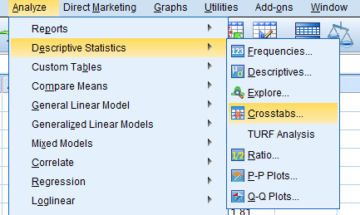
Workshop 5: Deciding on which Statistical Test to Use
2. For the questions “Do most of the hired care for the patients with SMI high school graduates?”, we employ frequency counts and make a cross tabulation between the type of care given and the educational attainment of the caregiver. From the data view of the SPSS data for nursing care SMI, click ANALYZE > DESCRIPTIVE STATISTICS > CROSSTABS

Slide 46
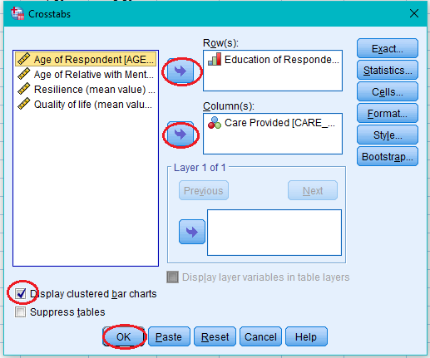
Workshop 5: Deciding on which Statistical Test to Use
Transfer to the Rows box the variable Education of Respondent and to the Columns box the variable Care Provided using the arrows. Click Display Clustered Bar Charts then click OK afterwards.

Slide 47
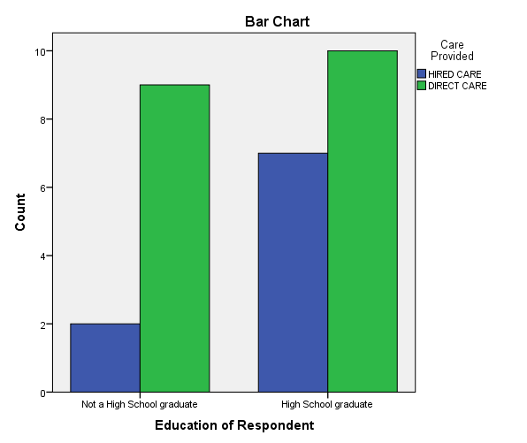
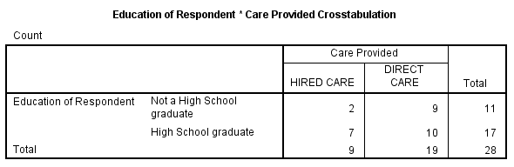
Workshop 5: Deciding on which Statistical Test to Use
Output:
Results indicate that most hired care caregivers of the patients with SMI are high school graduates.

Slide 48
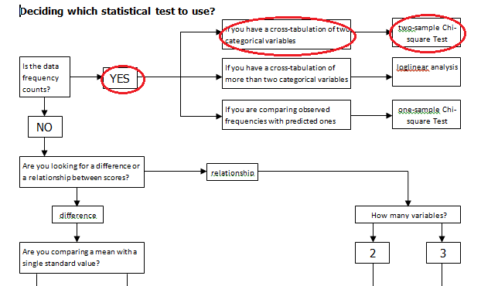
Workshop 5: Deciding on which Statistical Test to Use
2.1 For the problem “Is there a significant relationship between the type of care provided for the family member with SMI and the caregivers educational attainment?”, we follow the inferential statistics guide. Note that we are dealing with the relationship between two variables using frequency counts here as indicated by the previous table and bar graph. Hence,

Slide 49
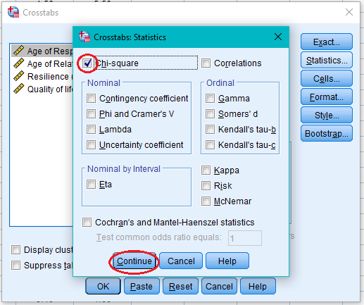
Workshop 5: Deciding on which Statistical Test to Use
To conduct a two-sample Chi-square test, from the data view of the SPSS file, click ANALYZE > DESCRIPTIVE > CROSSTABS. Then transfer to the Rows box the variable Education of Respondent and to the Columns box the variable Care Provided using the arrows. Note that this was the same procedure as before. Next click Statistics then check Chi-square. Click Continue and then click OK after.

Slide 50
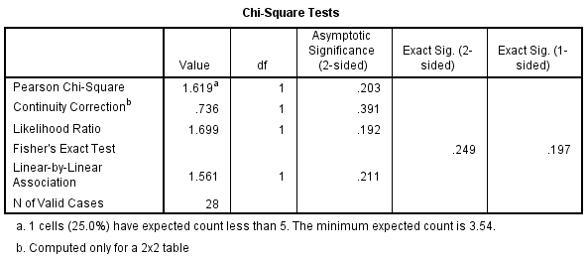
Workshop 5: Deciding on which Statistical Test to Use
Output:
Results indicate that for a two-tailed test, there is no significant relationship with the type of care given to the patient with SMI and the educational qualification of the caregiver (χ² (1)=1.619, p>0.05).

Slide 51
Workshop 6: Deciding on which Statistical Test to Use (Correlation)
Consider the data for nursing care SMI. Provide descriptive statistics and inferential statistics for the following research problems:
What is the average QOL of families with SMI? What is the mean resilience of the families with family members with SMI?
3.1 Is there a significant relationship between the level of resilience and the QOL of the families with family members with SMI?

Slide 52
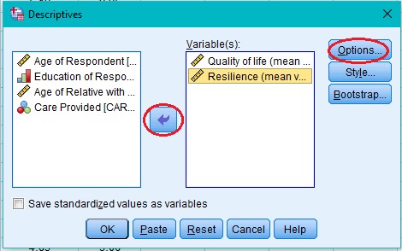
Workshop 6: Deciding on which Statistical Test to Use
3. For the mean QOL and mean resilience of the families with SMI, we click ANALYZE > DESCRIPTIVE STATISTICS > DESCRIPTIVES. Then we transfer the variables Quality of life and Resilience to the Variable(s) box using the arrow and then click OPTIONS afterwards.

Slide 53
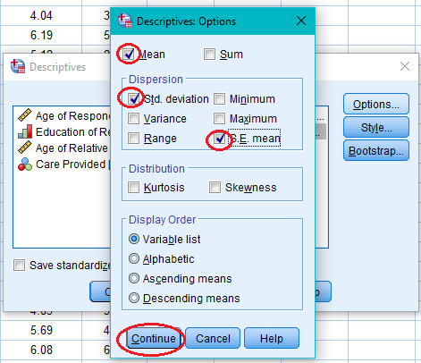
Workshop 6: Deciding on which Statistical Test to Use
Check the Mean, Standard deviation, and Standard error of the mean then click Continue. Click OK.

Slide 54
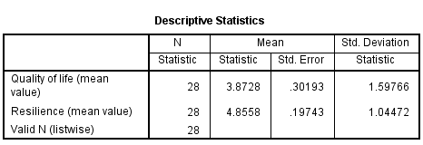
Workshop 6: Deciding on which Statistical Test to Use
Output:
The overall QOL mean value is 3.87 (s=1.60) indicating that most of those with family members with SMI had a “mixed feelings of satisfaction”. On the other hand, the families have a resilience level of 4.86 (s=1.04).

Slide 55
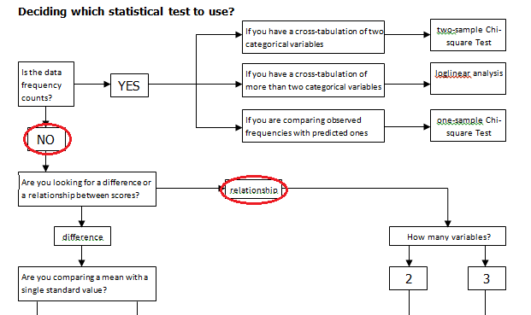
Workshop 6: Deciding on which Statistical Test to Use
3.1 For the research problem, “Is there a significant relationship between the level of resilience and the QOL of the families with family members with SMI?”, we are looking for relationship between two numerical variables. We use the inferential statistics guide as follows:

Slide 56
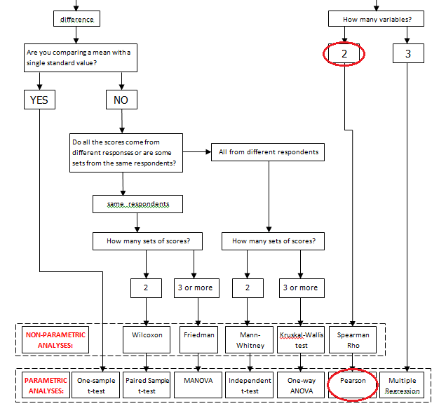
Workshop 6: Deciding on which Statistical Test to Use

Slide 57
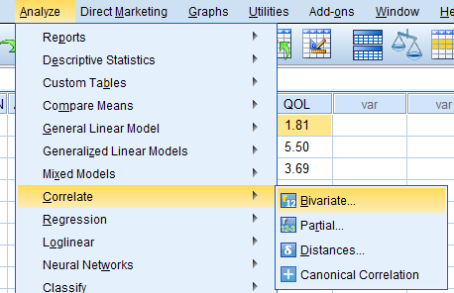
Workshop 6: Deciding on which Statistical Test to Use
To perform a Pearson correlation, from the SPSS data editor of the data, we click ANALYZE > CORRELATE > BIVARIATE.

Slide 58
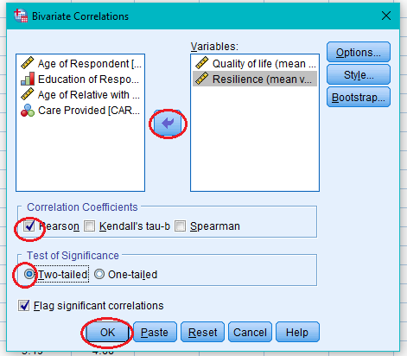
Workshop 6: Deciding on which Statistical Test to Use
Transfer the variables Quality of life and Resilience unto the Variable(s) box using the arrow. Make sure that the Pearson is checked. Here we are to perform a two-tailed test since there is no indication in the problem whether the relationship is positive or negative. Click OK afterwards.

Slide 59
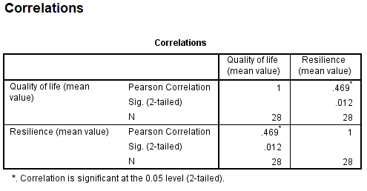
Workshop 6: Deciding on which Statistical Test to Use
Output:
Results indicate that there is a moderately positive correlation between the family’s resilience and the QOL that they have. Also, results indicate that this correlation is significant at the 0.05 level (r=.469, p<0.05).

Slide 60


